Slide 1

IFI 8420 Business Machine Learning Final Project Group 3 Shreyashi Mukhopadhyay Telecom customer churn prediction: IBM Dataset

Slide 2
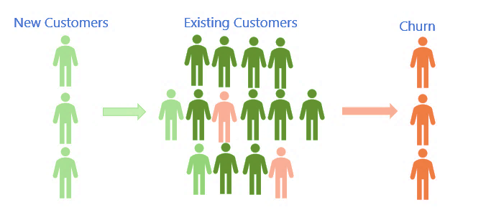
Business Question: Customer Churn Analysis
Companies invest a lot to acquire new customers.
When a customer leaves the company (churns), it is a loss of investment for the company.
Cost, time, and effort need to be invested to replace customers who have left the service.
Acquiring new customers is often more difficult and more expensive than retaining existing customers.
https://hbr.org/2014/10/the-value-of-keeping-the-right-customers

Slide 3


Data Source: Kaggle
The data has been sourced from Kaggle at: Telco customer churn: IBM dataset (kaggle.com)

Slide 4
Data Description
 | Null Count
Churn_Reason | 5174
Total_Charges | 11
CustomerID | 0
Count | 0
Country | 0
Zip_Code | 0
Lat_Long | 0
State | 0
City | 0
Gender | 0
Senior_Citizen | 0
Partner | 0
Dependents | 0
Tenure_Months | 0
Phone_Service | 0
Latitude | 0
Longitude | 0
Internet_Service | 0
Multiple_Lines | 0
Online_Security | 0
Online_Backup | 0
Streaming_TV | 0
Streaming_Movies | 0
Device_Protection | 0
Tech_Support | 0
Paperless_Billing | 0
Contract | 0
Monthly_Charges | 0
Payment_Method | 0
Churn_Label | 0
Churn_Value | 0
Churn_Score | 0
CLTV | 0
Number of rows: 7043
Number of columns: 33
Object: 24
Int64: 6
Float64: 3
The Churn Reason column has 5174 missing values because these customers have not churned.

Slide 5
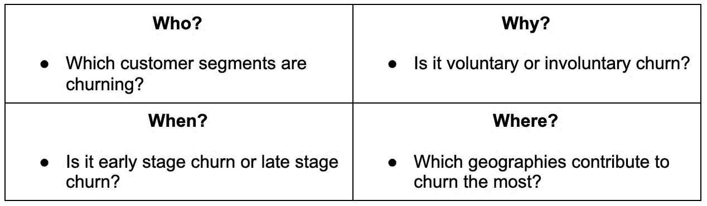
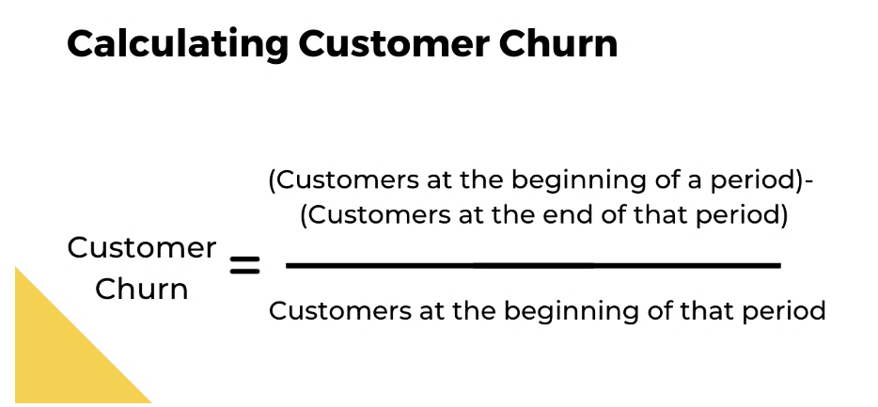
Churn rate calculation
Reasons:
- Inadequate service quality
- Network coverage or performance issues
- Billing process complications
- Better competitive offers
- Negative customer service experiences
https://www.chargebee.com/blog/reduce-customer-churn/

Slide 6
EDA

Slide 7
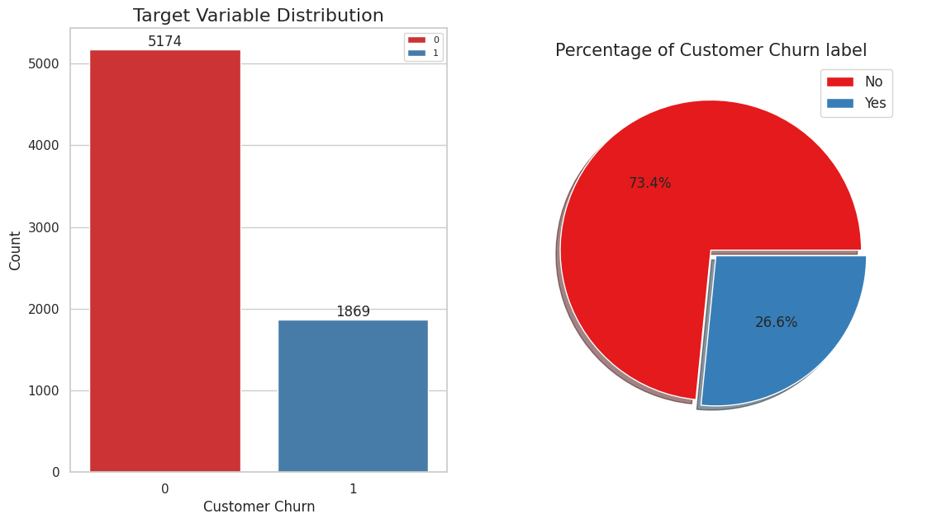


Target Variable Distribution: Churn_Label
Imbalanced Data
73.4%
26.6%

Slide 8
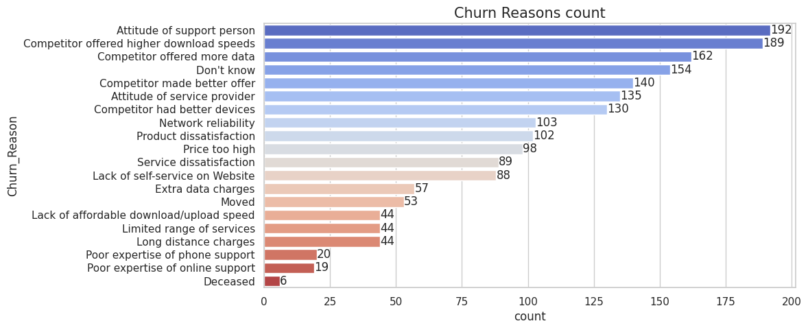


Customer Churn Reasons
Attitude of the support person and Competitor offers were the main reasons for the customer churn.

Slide 9
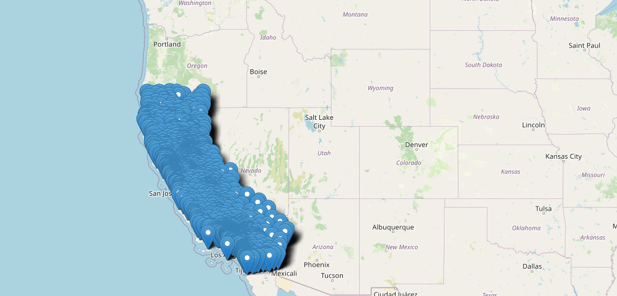
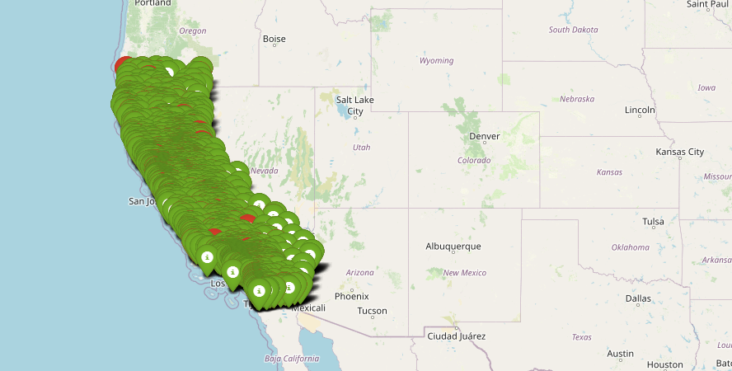
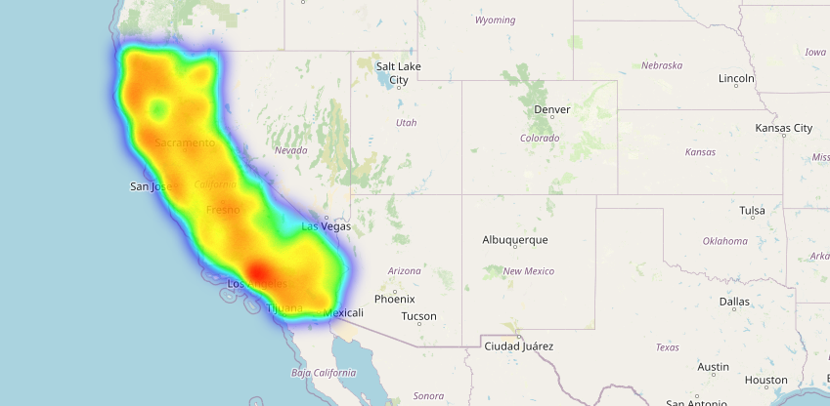
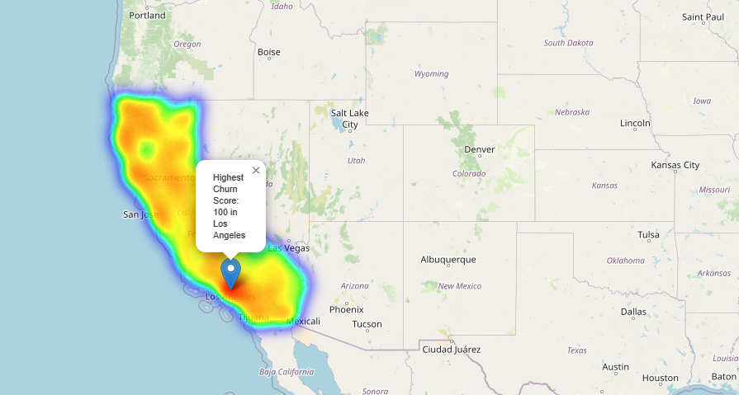
Geographical Distribution of Customer Churn
Data Distribution
Churn values Distribution
Monthly Charges Distribution
Churn Score Distribution

Slide 10
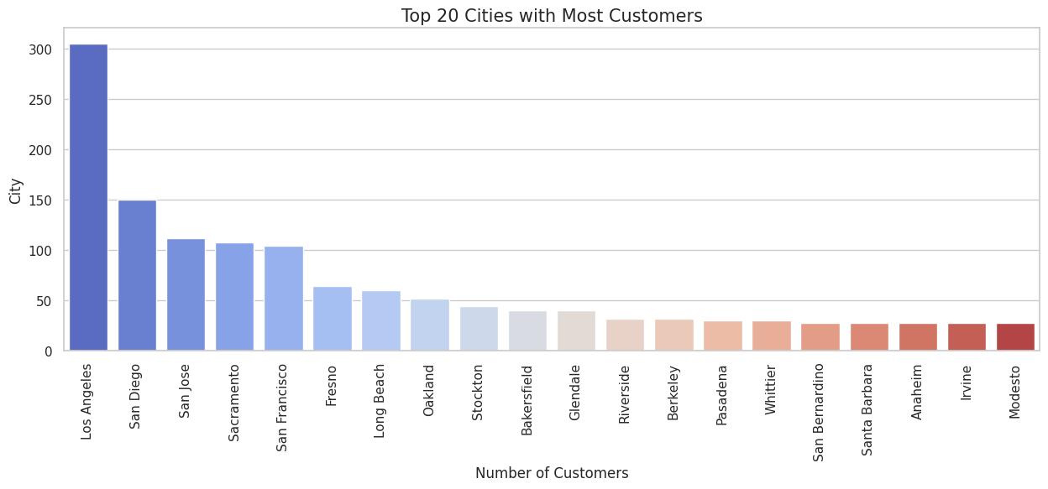
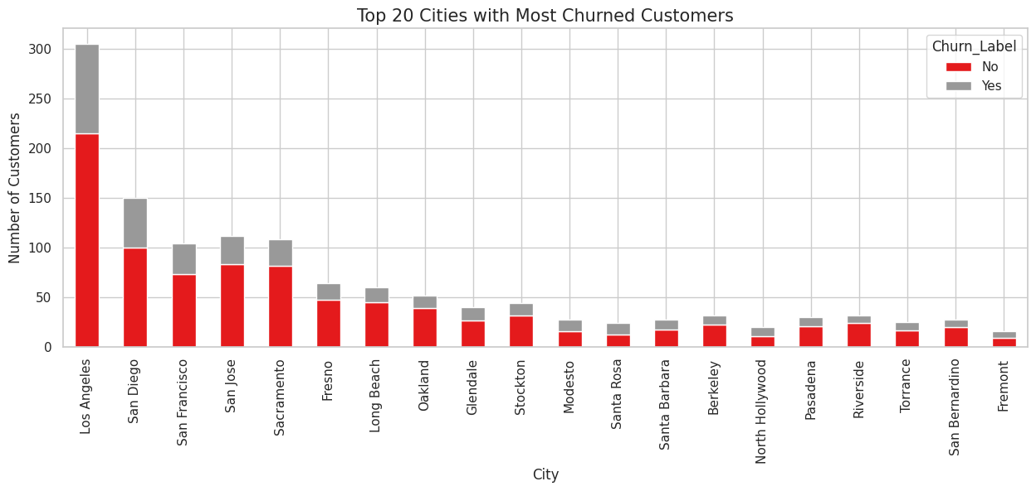

Distribution of Customer Churn by City
Los Angeles, San Diego, San Francisco, San Jose, Fresno, Long Beach and Oakland have the highest customers and hence the churn values are also high.

Slide 11
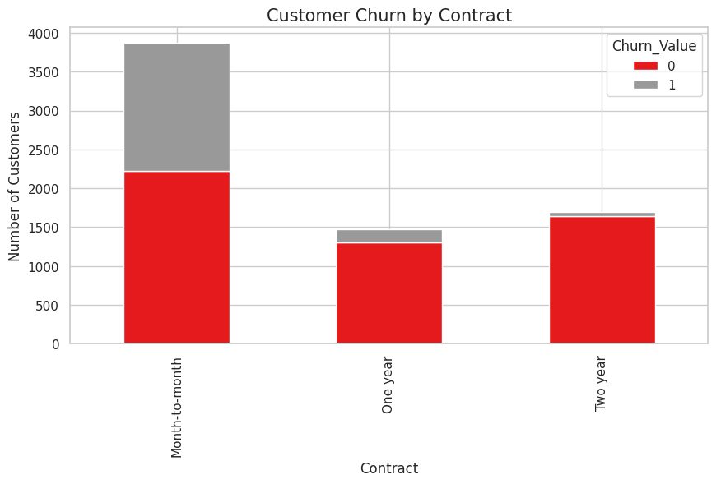
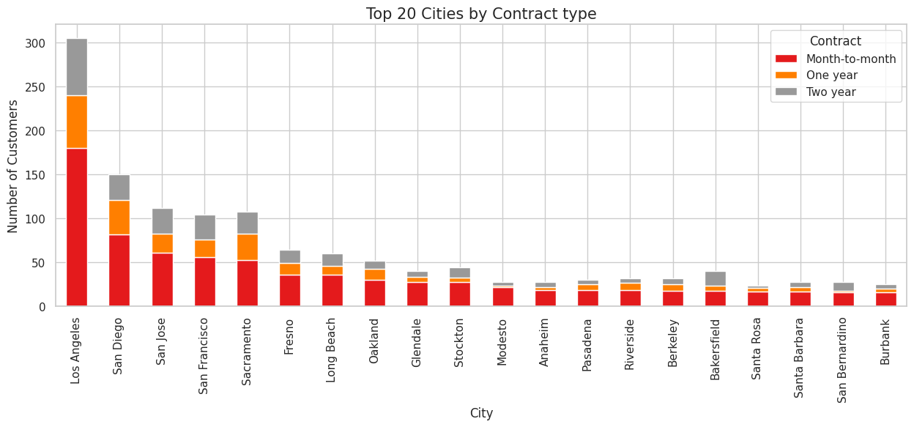
Distribution of Customer churn by Contract type across Cities
Los Angeles, San Diego, San Francisco, San Jose, Fresno, Long Beach and Oakland have the highest Monthly contracts, followed by one-year contracts and two-year contracts.

Slide 12
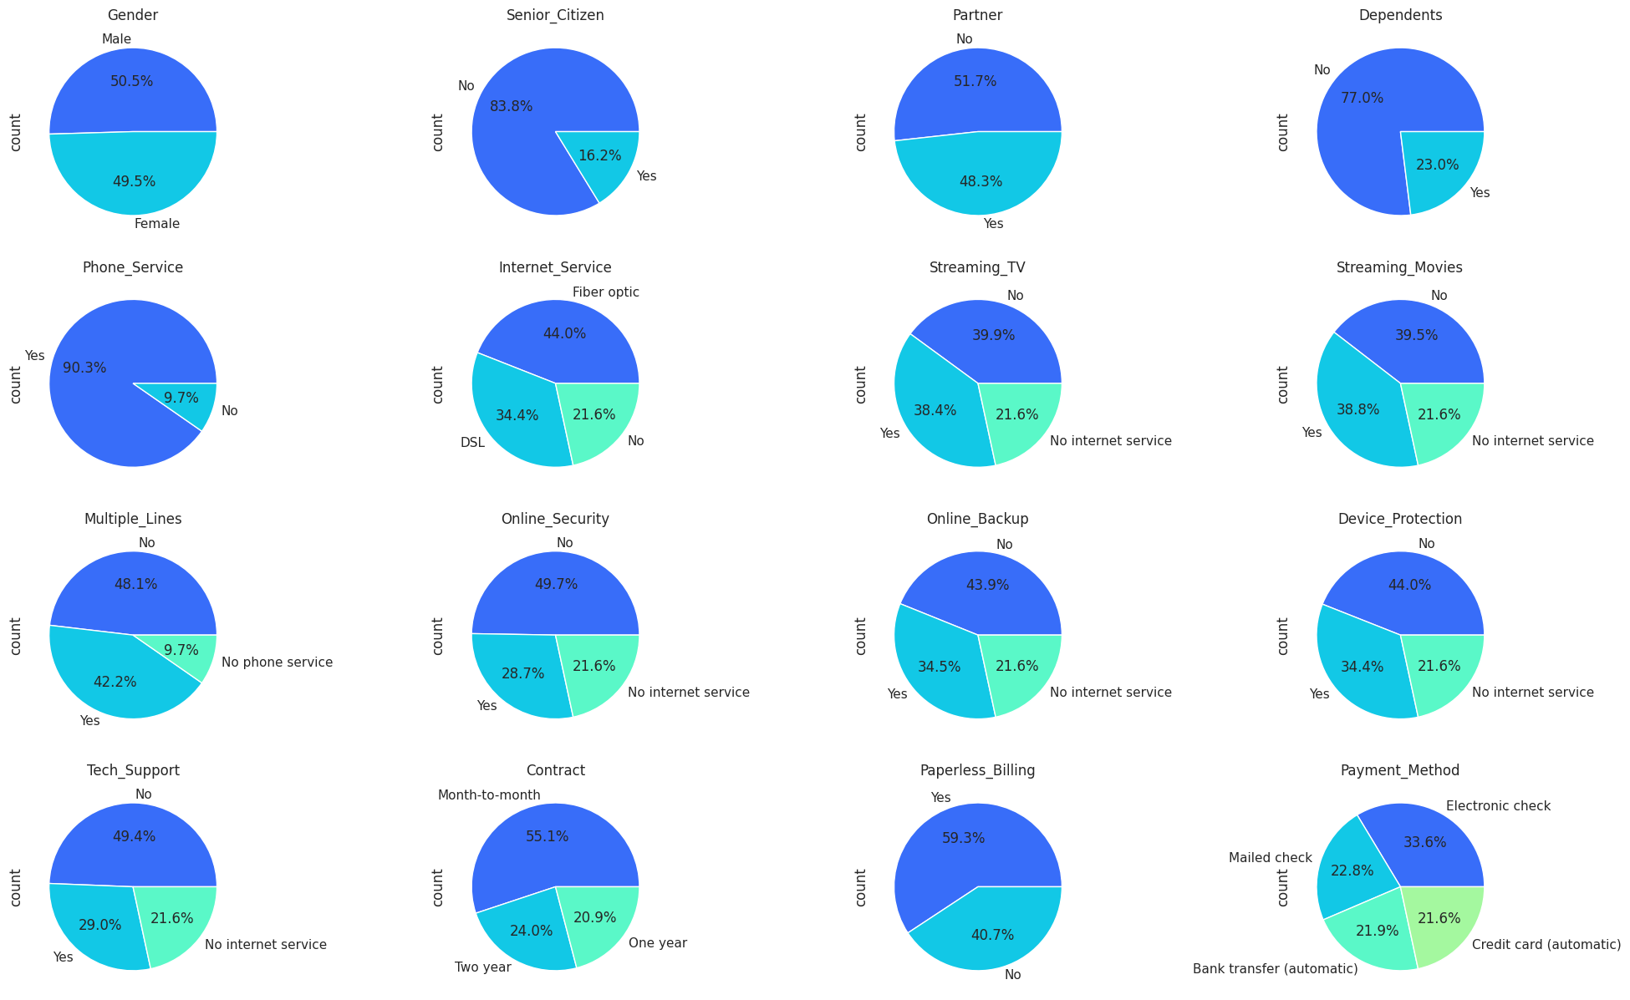

Distribution of Products and Services
Equal Distribution of Gender
Few Senior Citizens
Low Dependents
High Month to month contracts
High subscription for Phone Service
High subscription for Multiple lines
Higher Fiber optic customers
High paperless billing preference

Slide 13
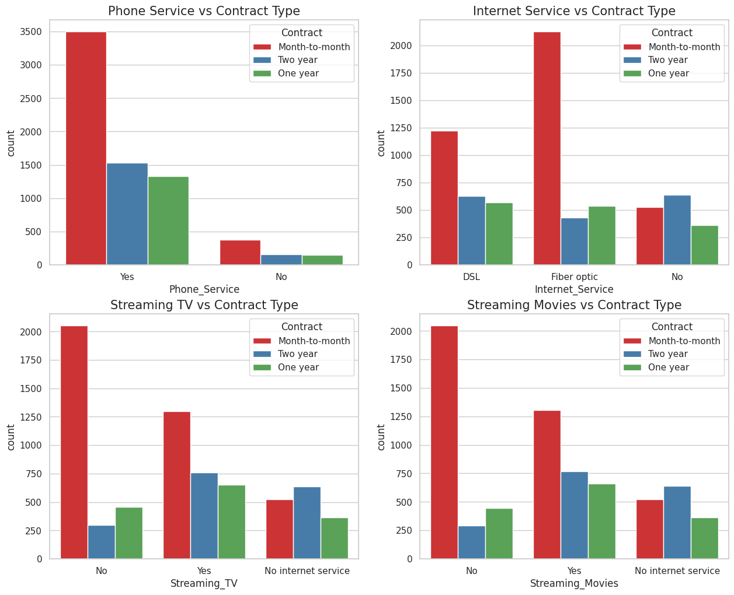
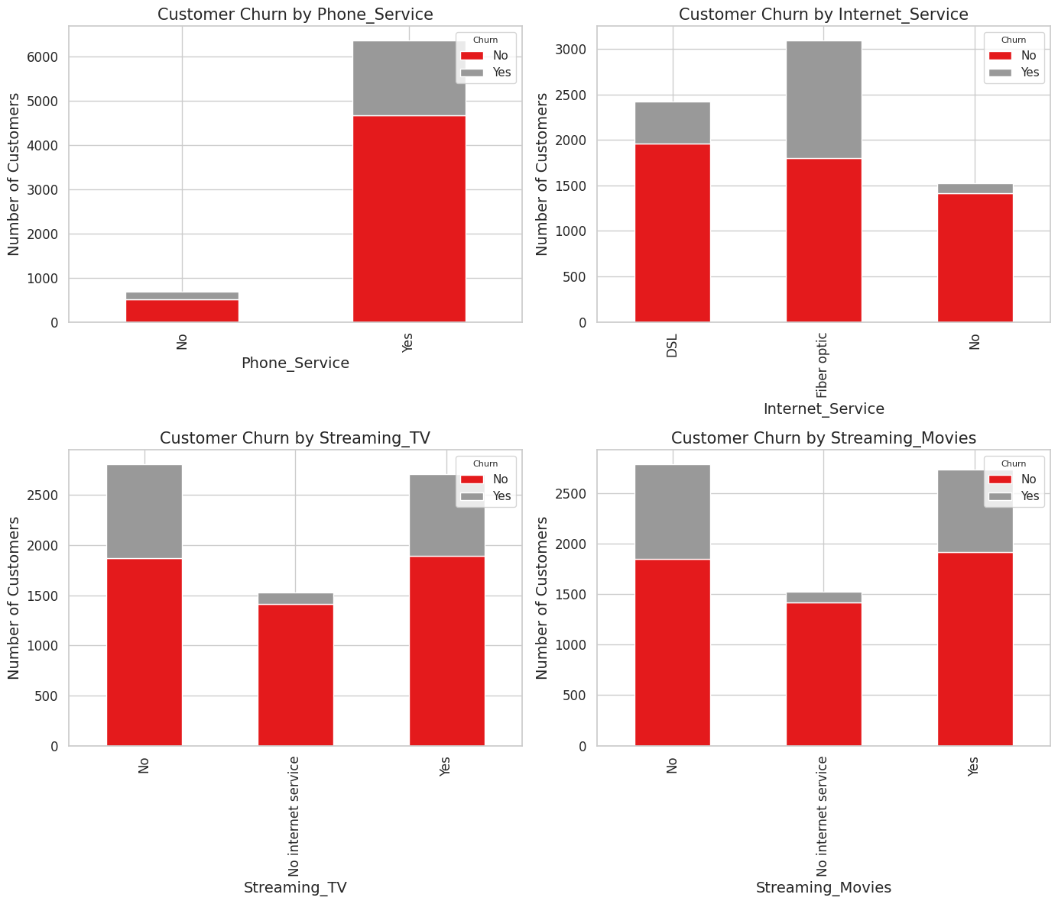
Distribution of Products by Contracts & Customer churn
Month-to-month contracts are most popular across all categories of Phone, Internet, TV streaming and Movie Streaming Services.
Phone services, TV streaming and Movie streaming show less customer churn whereas Internet service shows high churn for Fiber optic service.

Slide 14
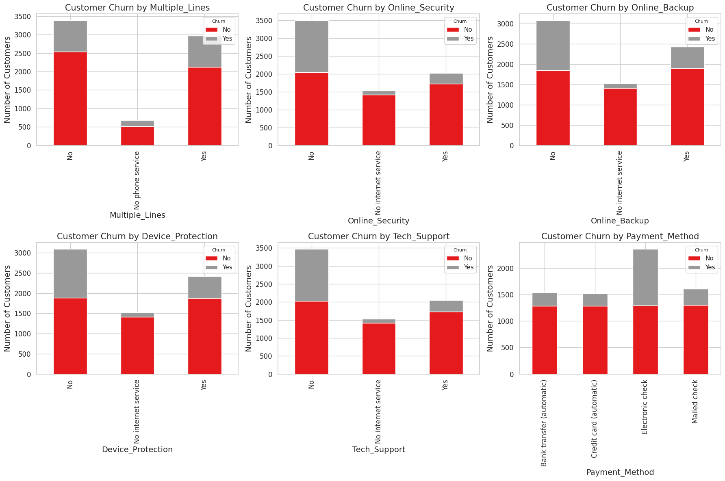

Distribution of Services by Customer churn
Customers prefer the Multiple lines, Online security, Online backup, Device protection, Tech support services and have very low churn value. Only the Electronic checks payment method has a high churn value.

Slide 15
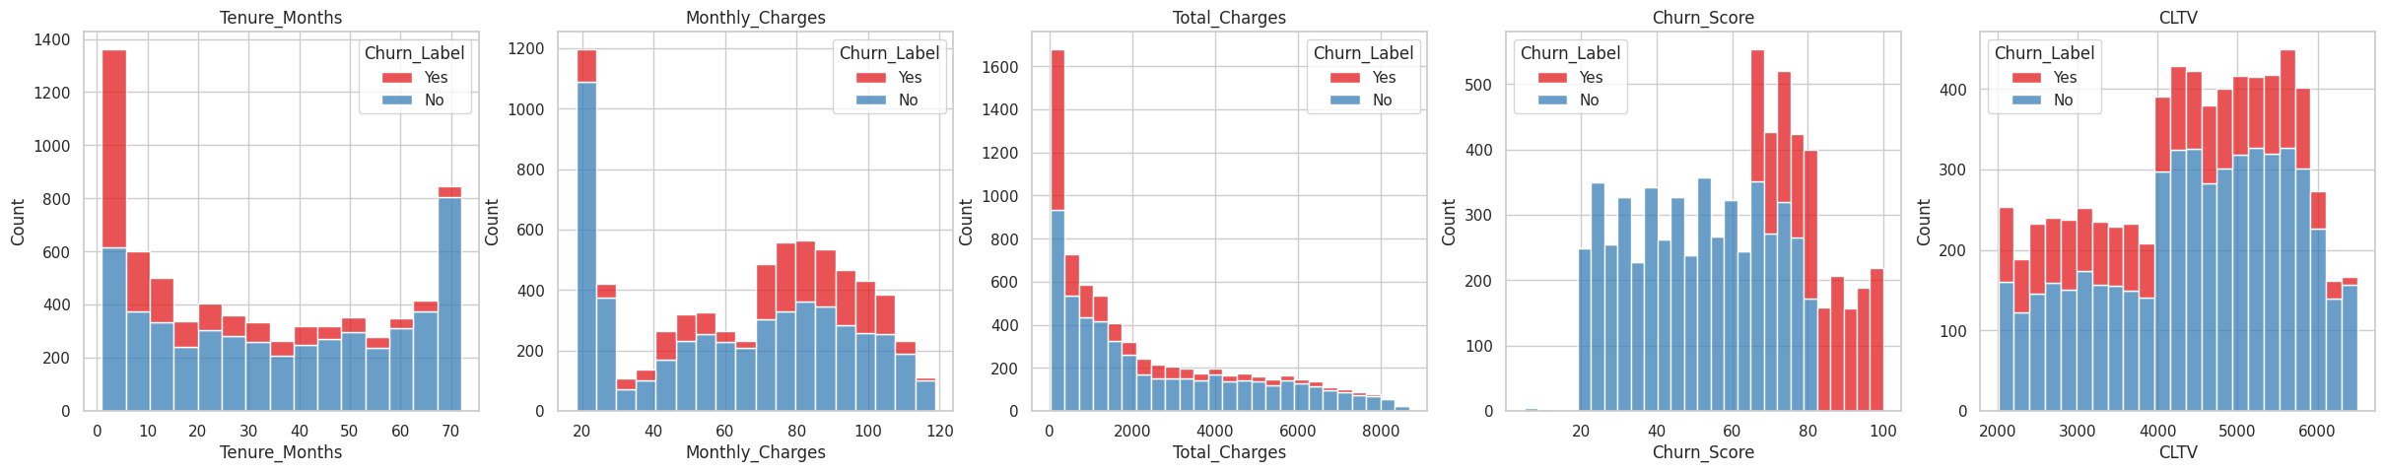
Distribution of Continuous Customer Attributes
Customer churn is high for less than 1 year contract, and it decreases after that.
Customer churn increases for higher monthly charges.
Customer churn is high for lesser total charges and decreases after that.
Churn score is higher for a score 65 and above.
Churn values are equal across all the Customer lifetime values.

Slide 16
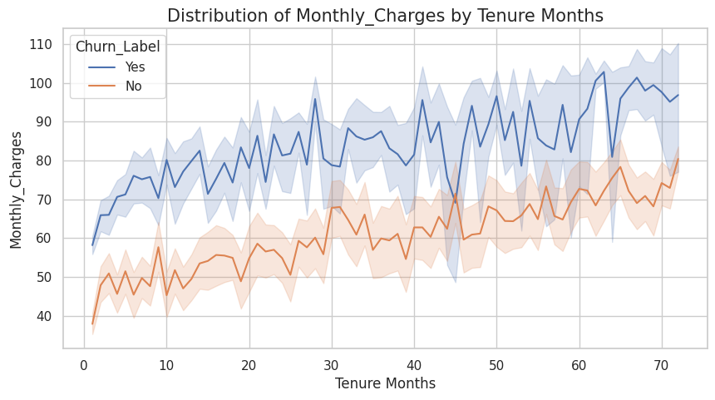
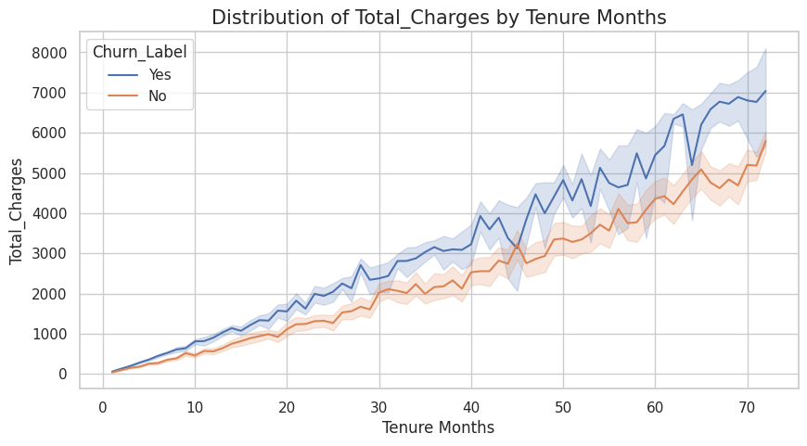
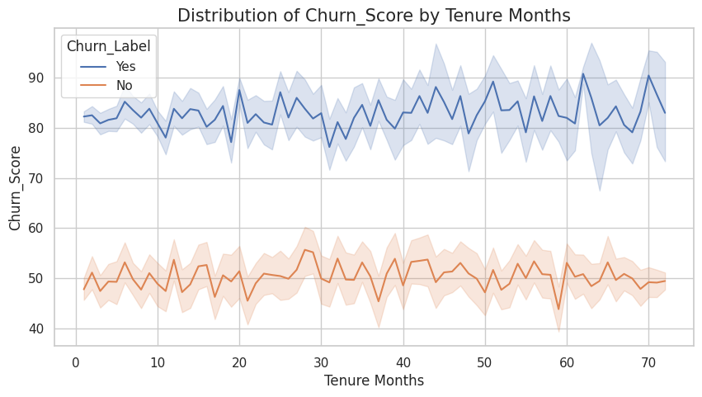
Customer Attribute Trends across Tenure Months
Monthly charges increases with the tenure months.
Total charges increases with increase in tenure months.
Churn score trends are constant and around 45-55 for no-churn customers whereas it is around 80-100 for customers who churn.

Slide 17
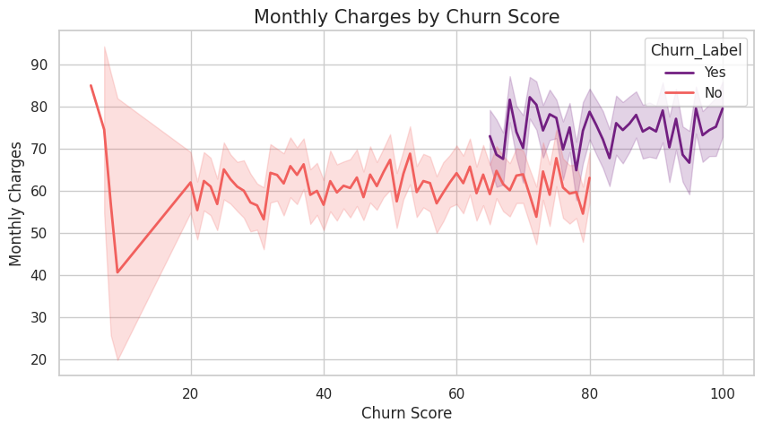
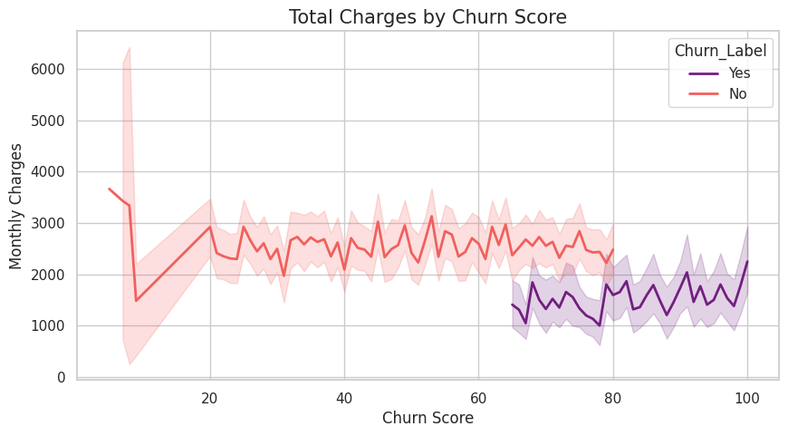

Customer Charges Patterns by Churn Score
Customers churn score increases beyond Monthly charges between $60-70.
Customer churn score is higher when Total charges between $1000 - 2000.

Slide 18
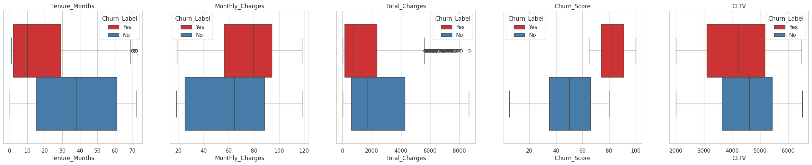
Box plots for outlier detection
There are very few outliers for the Tenure months and the Total charges features.
We will keep these data points to utilize the information for customer behavior from these data points.

Slide 19
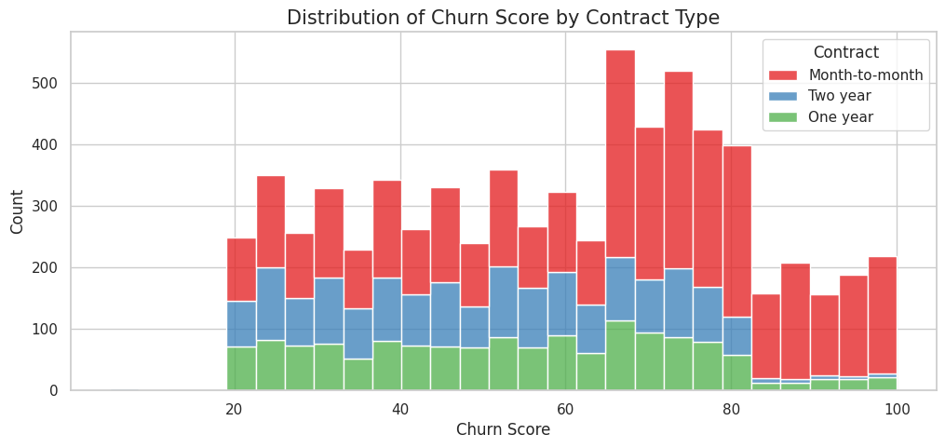
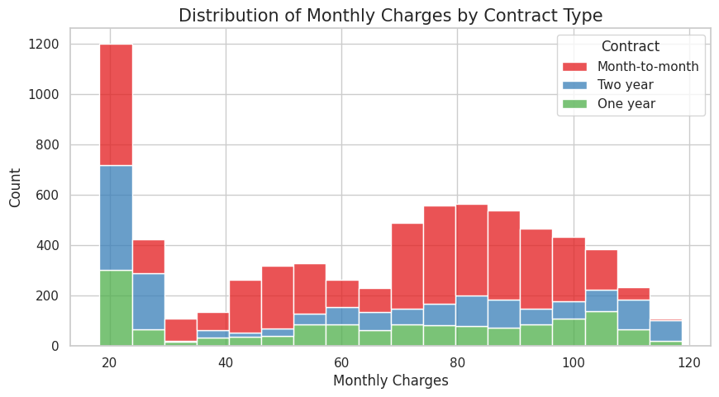
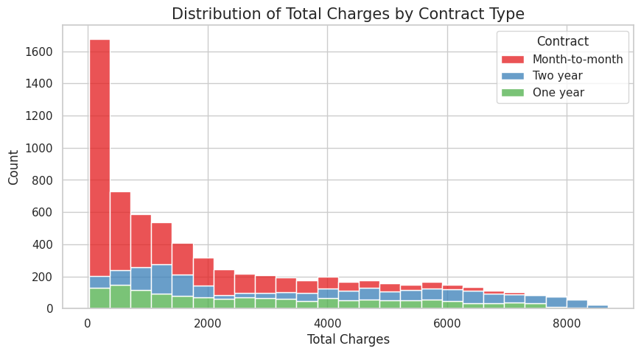

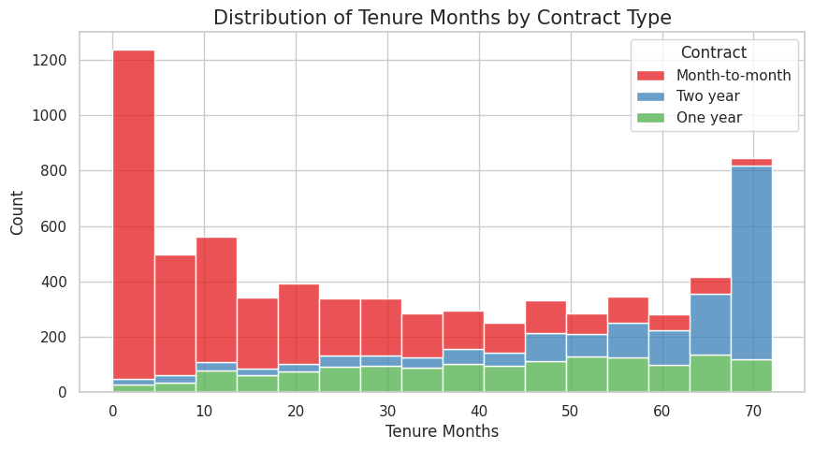
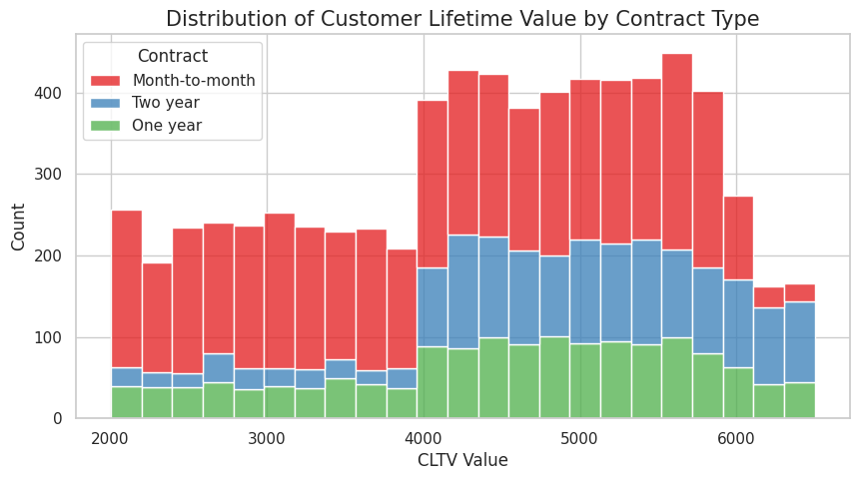
Distribution of Numerical Attributes by Contracts
The month-to-month contract type has the highest value across all continuous customer attributes across all contract types as the customer’s preferred product followed by Two-year plans and One-year plans.

Slide 20
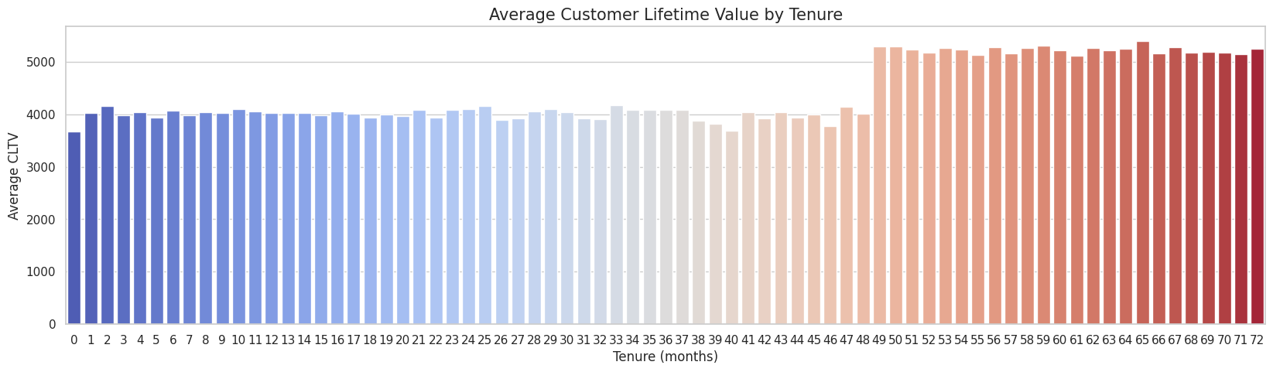

Average Customer Lifetime Value with Tenure months
The Customer Lifetime value is constant around 4000 for the first 48 months and then it suddenly increases to around 5000 beyond the 48 months.

Slide 21
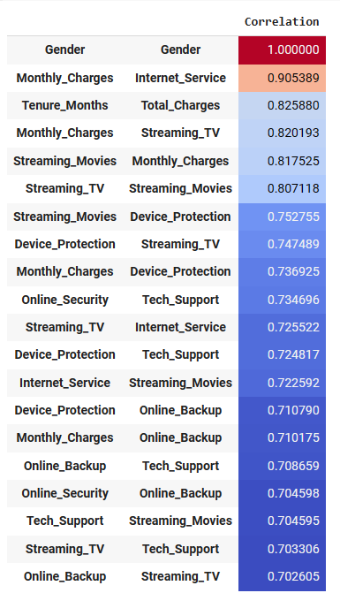
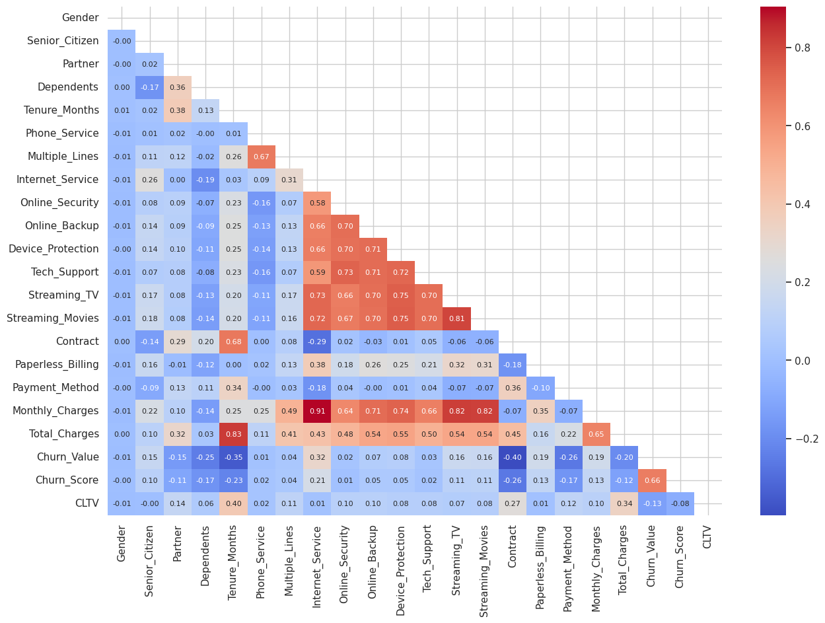
Correlation Heatmap
Many of the products and services show high correlation which shows the customer’s tendency to bundle products and services.

Slide 22
Machine Learning

Slide 23
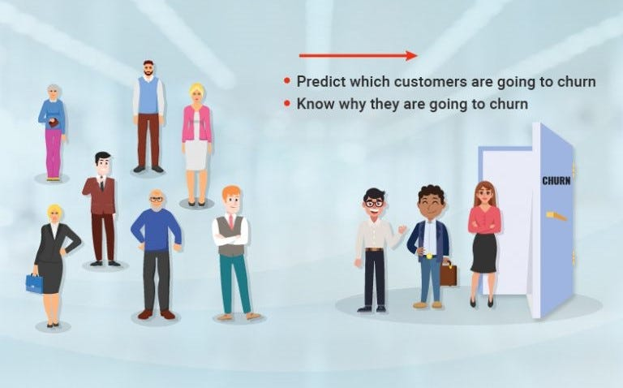

Churn Prediction with Machine Learning

Slide 24

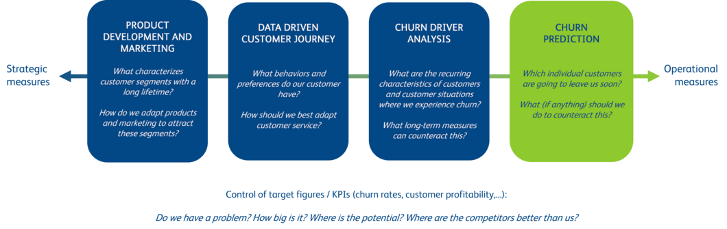
Machine learning & Churn Management
Machine Learning
Product pricing strategy
https://www.bearingpoint.com/en-no/insights-events/blog/tips-for-predicting-and-preventing-churn/

Slide 25
Model Fitting
Pre-Preprocessing
Classification Models
Logistic Regression
XG Boost
Decision Trees
Random Forest
KNN
ADA Boost
CAT Boost
Feature Encoding
Min-max scaling
PCA
Model Fitting
K-Fold Cross Validation
SMOTE

Slide 26
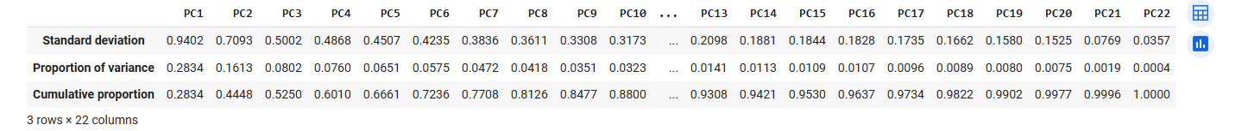
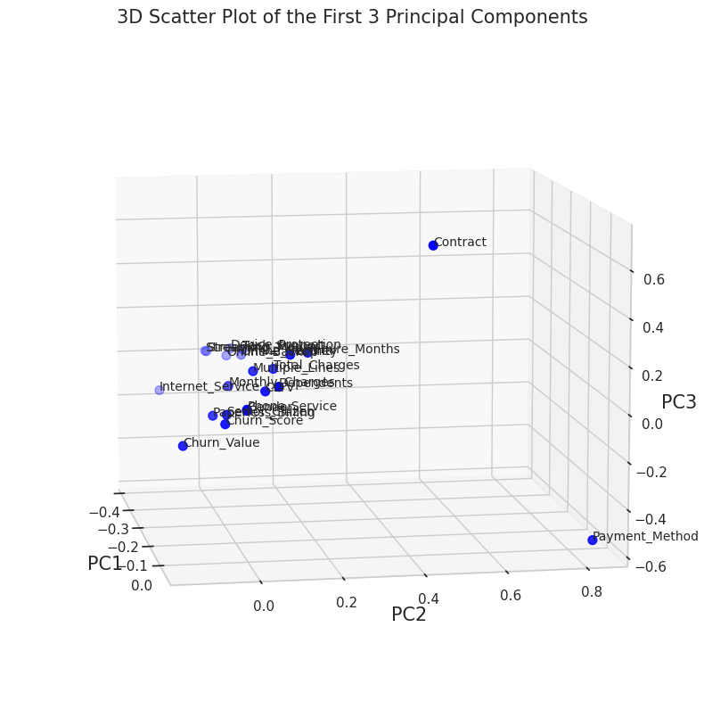
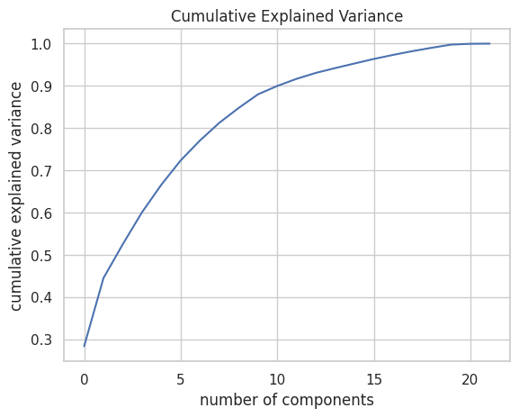
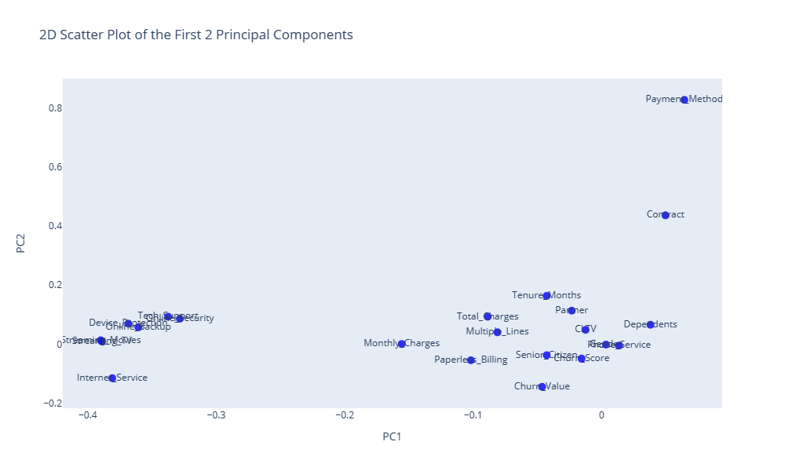
PCA – Dimensionality Reduction
n_Components = 21

Slide 27
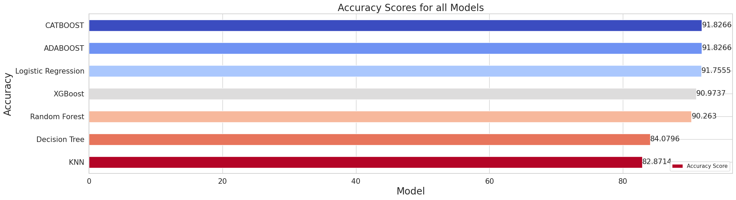
Model Performance
CATBoost and ADABoost models have the highest accuracies followed by Logistic Regression.

Slide 28
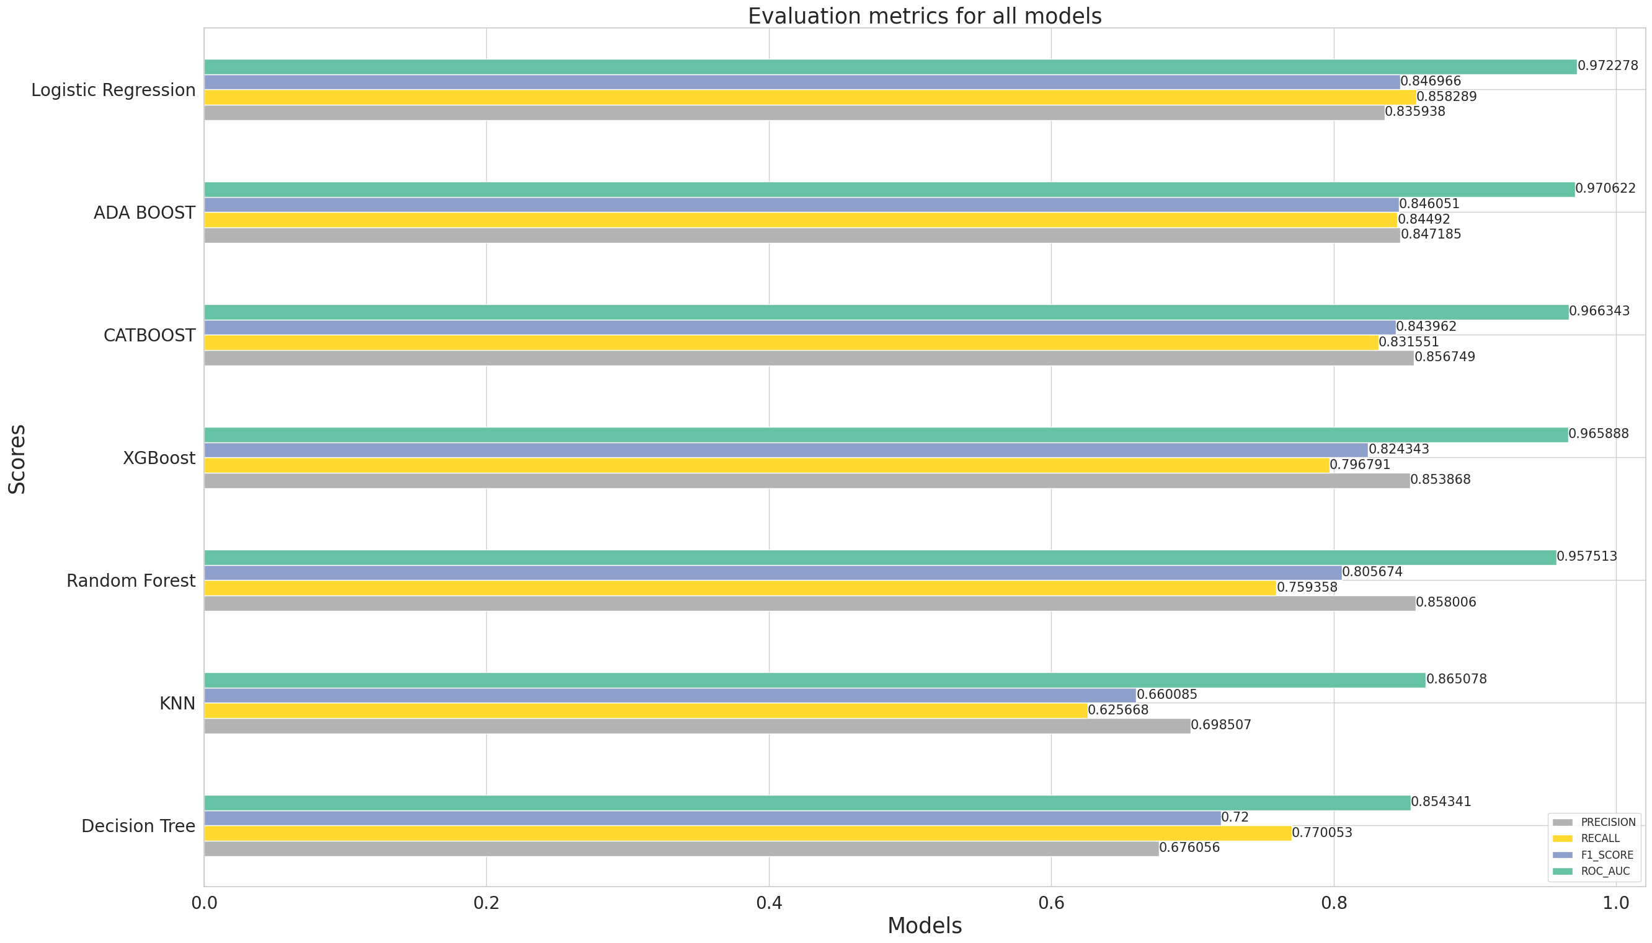
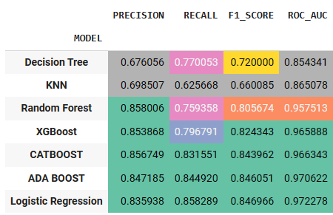
Model Evaluation Metrics

Slide 29
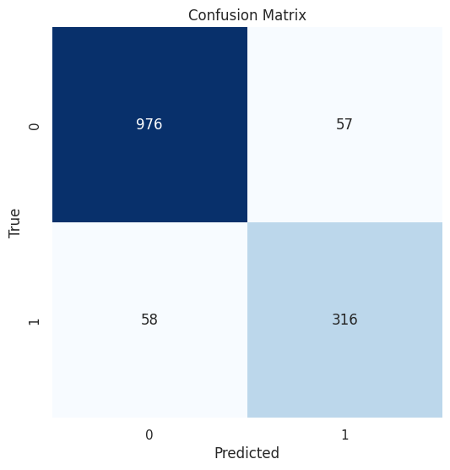
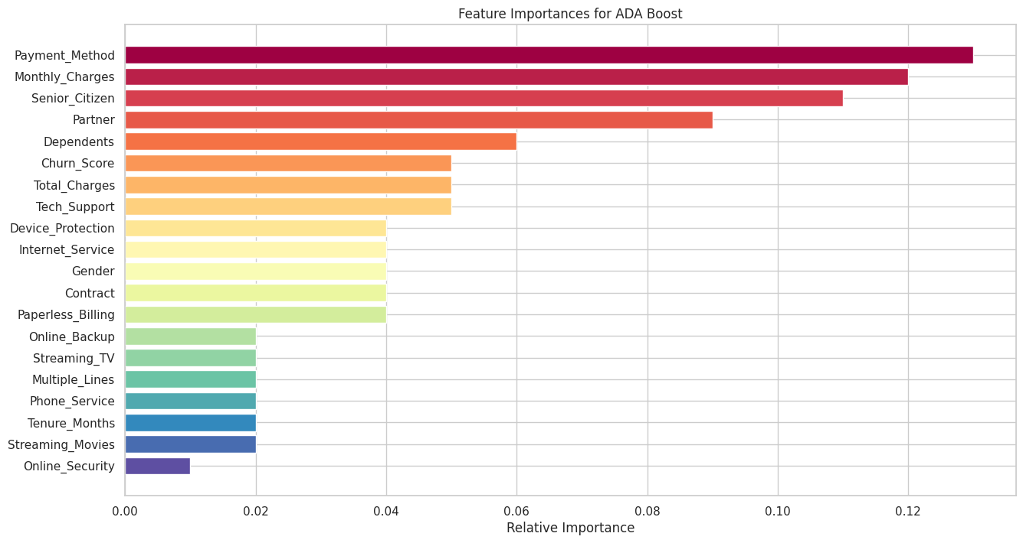
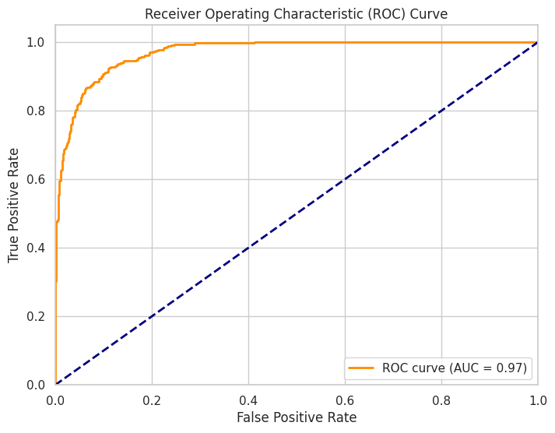
Feature Importances with ADA Boost
Accuracy = 0.9182658137882018 Precision: 0.8471849865951743 Recall: 0.8449197860962567 F1 Score: 0.8460508701472558
ROC Area under Curve = 0.8948703480336075

Slide 30
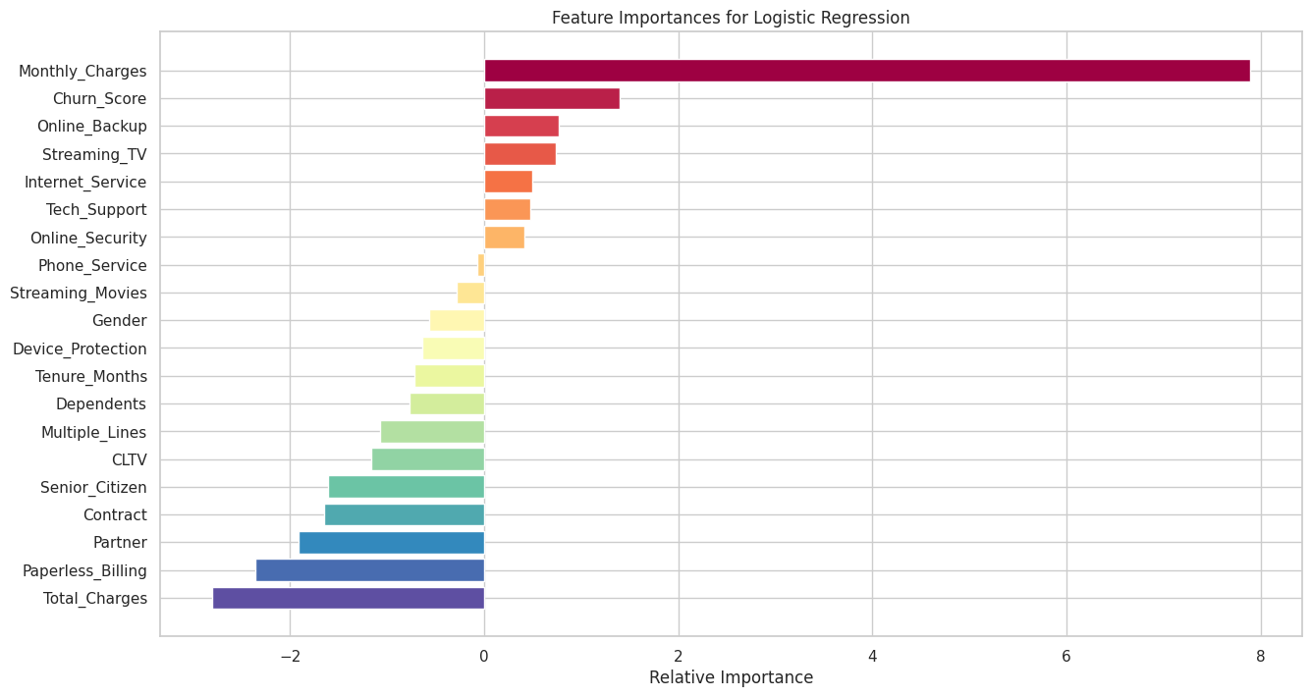
Logistic Regression Feature Importances
A positive coefficient means that an increase in the feature value will increase the log odds of the positive class, making it more likely.
Accuracy:0.9175550817341862 Precision: 0.8359375 Recall: 0.8582887700534759 F1 Score: 0.8469656992084431
ROC Area under Curve: 0.8986506773791098
A negative coefficient means that an increase in the feature value will decrease the log odds of the positive class, making it less likely.
How To Get Feature Importance In Logistic Regression | Forecastegy

Slide 31
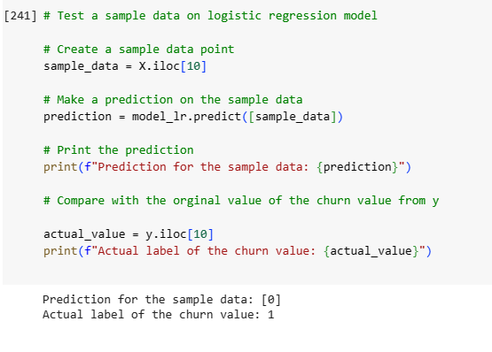
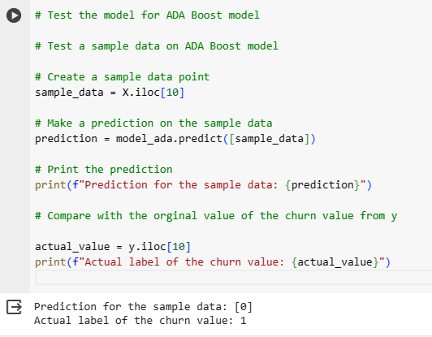
Model testing on sample data
Logistic Regression and Ada Boost fail to predict the classes accurately.
Logistic Regression
ADA Boost

Slide 32
K-Fold Cross Validation

Slide 33
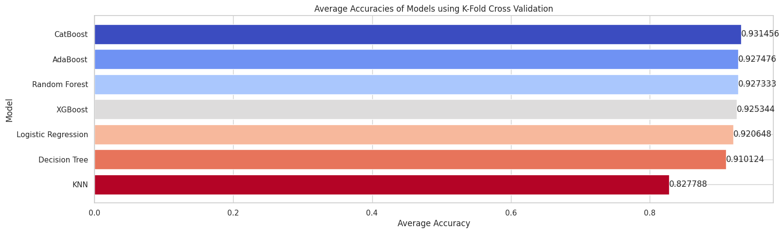
Model Comparison K-Fold
The CATBoost model performs the best in terms of accuracy for K-fold cross-validation.

Slide 34
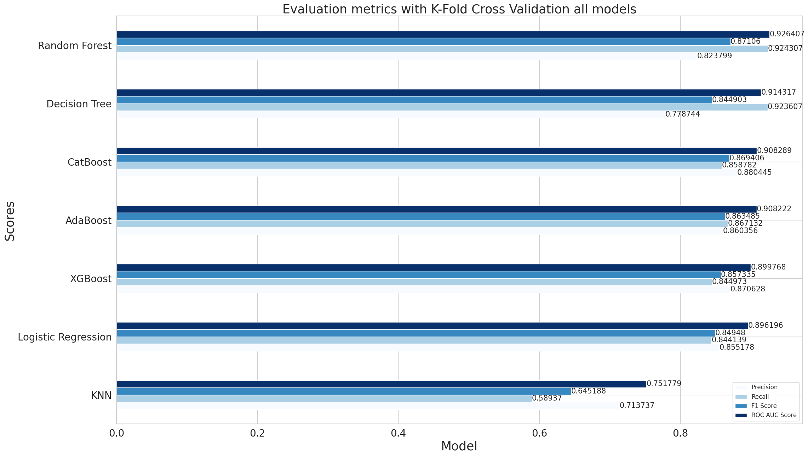
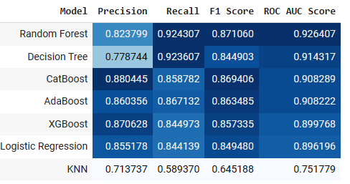
Evaluation metrics K-fold cross validation

Slide 35



Best model: K-Fold Random Forest (Recall Score & ROC AUC Score)
Average Accuracy: 0.9273328541199712
Average Precision: 0.8237988209809695
Average Recall: 0.9243067611447424
Average F1 Score: 0.8710603165192733
Average ROC AUC Score: 0.9264066049150225

Slide 36

Model testing for Random Forest K-fold on sample data

Slide 37
SMOTE

Slide 38


Model Accuracy comparison with SMOTE
XGBoost model performed with highest accuracy followed by CatBoost

Slide 39


Evaluation metrics comparison with SMOTE
ADA Boost Model performs the best with highest Precision, Recall, F1 Score and ROC-AUC Score

Slide 40



Feature Importances with ADA Boost SMOTE
Accuracy: 0.9424007744433688
Precision: 0.932573599240266
Recall: 0.9533980582524272
F1 Score: 0.9428708593374939
ROC AUC Score: 0.9424326198598044

Slide 41

Model Testing for Sample data with ADA Boost SMOTE
Model predicts the classes accurately.

Slide 42
Conclusions

Slide 43
K Fold Random Forest
VS
ADA Boost Smote
Top features for Churn Prediction
Random Forest
K-Fold
ADA Boost with SMOTE
Churn Score
Contract Type
Tenure Months
Total Charges
Internet Service
Monthly Charges
Dependents
Customer Lifetime Value (CLTV)
Churn Score
Tenure Months
Monthly Charges
Customer Lifetime Value (CLTV)
Total Charges
Contract
Internet Service
Payment Method
Tree based Algorithms and Boosting Algorithms performed best.

Slide 44


Random Forest K-Fold
ADA Boost SMOTE
Feature Importances Comparison

Slide 45

Suggestions

Slide 46

Questions?

Slide 47

Thank you!

Slide 48

Appendix

Slide 49
Data Dictionary
CustomerID | A unique ID that identifies each customer.
Count | A value used in reporting/dashboarding to sum up the number of customers in a filtered set.
Country | The country of the customer's primary residence.
State | The state of the customer's primary residence.
City | The city of the customer's primary residence.
Zip Code | The zip code of the customer's primary residence.
Lat Long | The combined latitude and longitude of the customer's primary residence.
Latitude | The latitude of the customer's primary residence.
Longitude | The longitude of the customer's primary residence.
Gender | The customer's gender
Senior Citizen | Male, Female
Partner | Yes, No
Dependents | Yes, No
Tenure Months | Yes, No.
Phone Service | Yes, No
Multiple Lines | Yes, No
Internet Service | No, DSL, Fiber Optic, Cable.
Online Security | Yes, No
Online Backup | Yes, No
Device Protection | Yes, No
Tech Support | Yes, No
Streaming TV | Yes, No.
Streaming Movies | Yes, No.
Contract | Month-to-Month, One Year, Two Year.
Paperless Billing | Yes, No
Payment Method | Bank Withdrawal, Credit Card, Mailed Check
Monthly Charge | Charge per month
Total Charges | Charges per quarter
Churn Label | Yes, No
Churn Value | 1,0
Churn Score | A value from 0-100
CLTV | Customer Lifetime Value.
Churn Reason | Reason for exit

Slide 50


Customer Churn patterns by charges across contracts
Customer churn is higher when the monthly charges and total charges are higher.
The company needs better customer service to advise customers on value-oriented plans for customer loyalty and retention.

Slide 51


Slide 52

Decision Tree visualization with max_depth=4

Slide 53

XGBoost Plot

